Slide 1
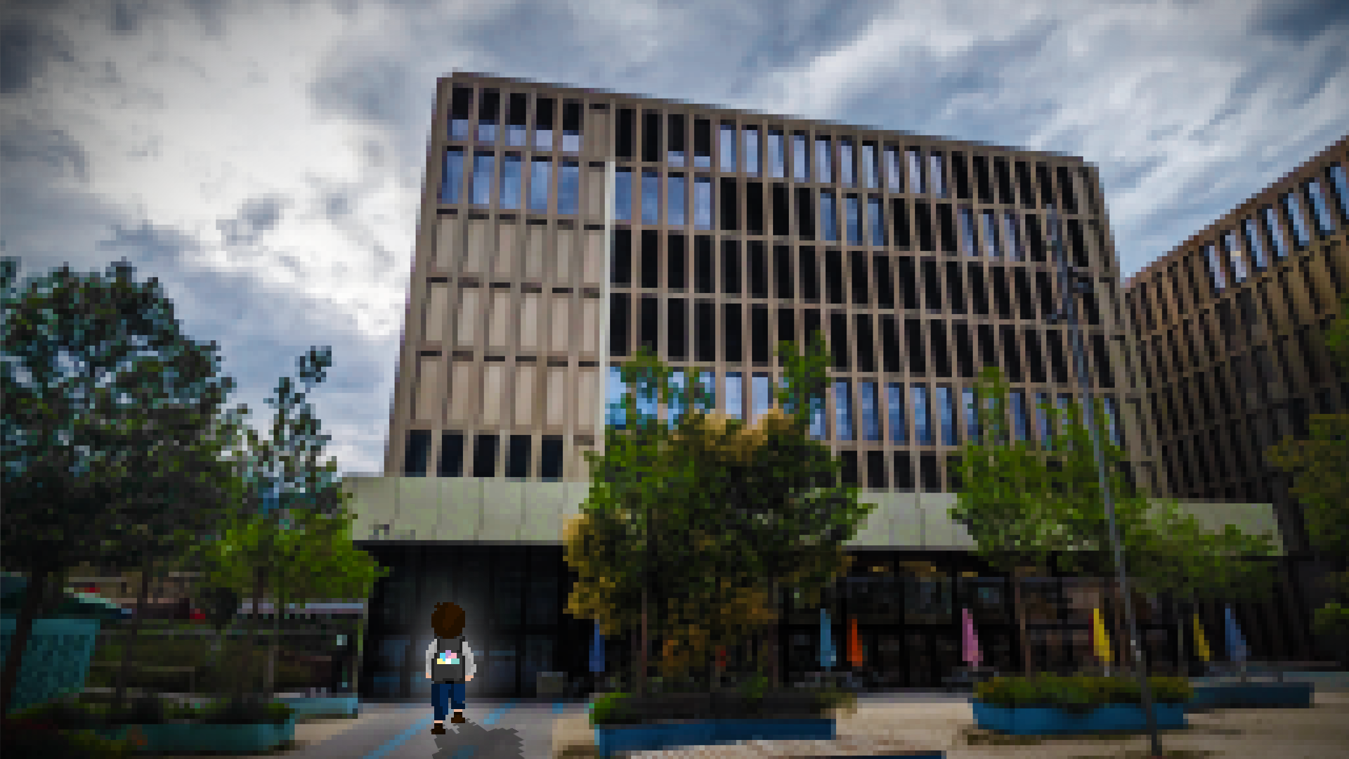
HES Survivor (early access)
Raphael Gonin Jonathan Muller

Slide 2
Table of Content
Introduction / concept
Game Preview
Project steps
Challenges & bugs
Real Demo
Questions

Slide 3
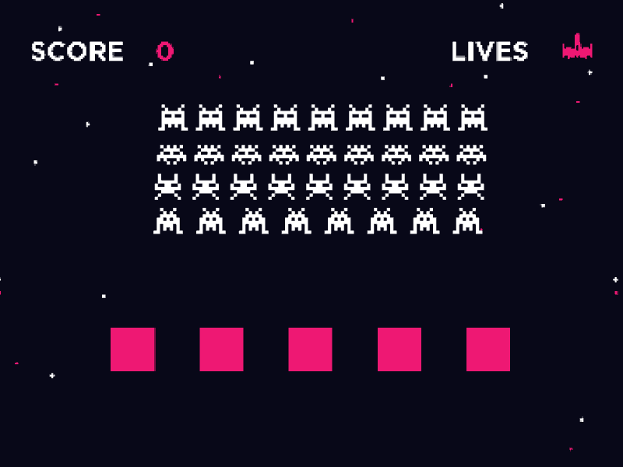
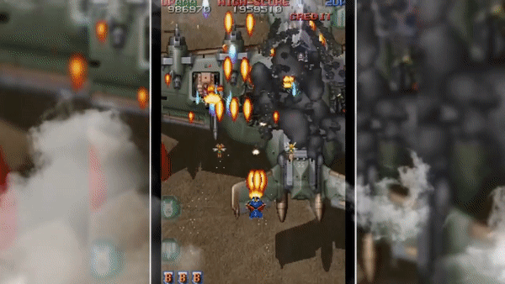
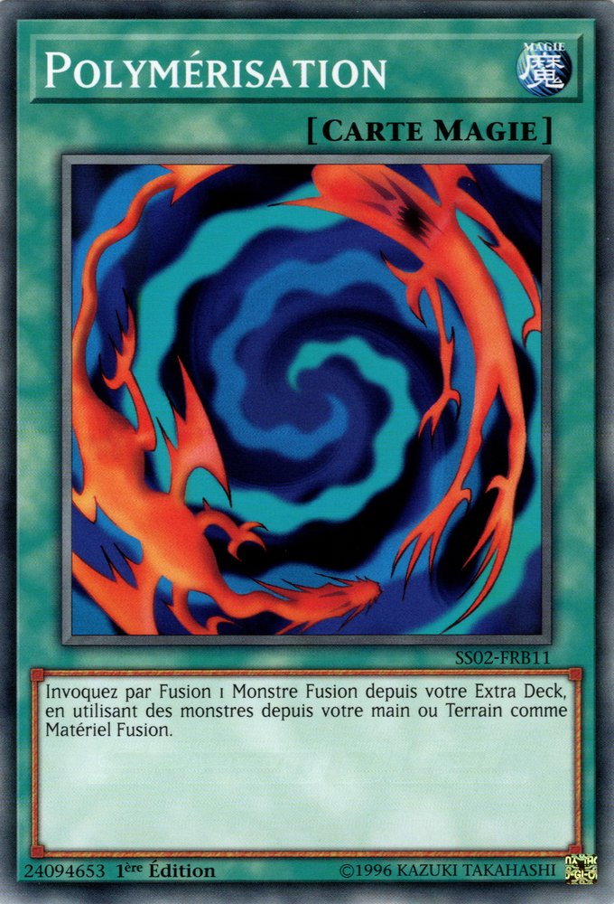
Introduction - models
Game inspired by Space Invaders and Raiden Legacy

Slide 4
Introduction - goals
A shooter Game use mouse to move you character and keys to shoot
Vertical design enemies coming from above and player fighting them
Sprites HES themed Player, enemies, bullets and background themed with HES skins
Enemies Variety different movement patterns and bullets for each enemy
Level Design 6 waves with increasing difficulty , and a boss wave
Difficulty and Gameplay LifePoint system, hitbox system , increasing with waves
Menu and Interface menu , controls and settings, win screen, repayable

Slide 5
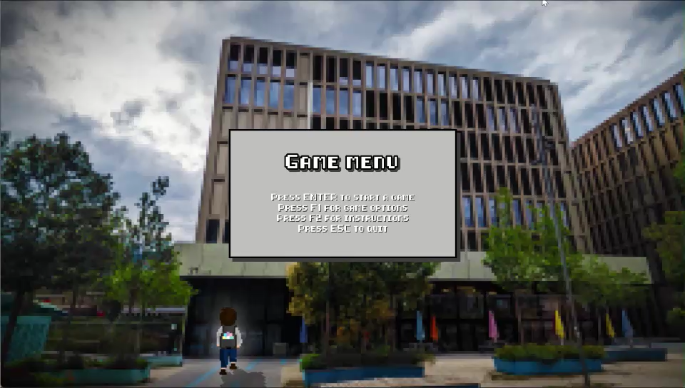
Introduction – Game preview

Slide 6
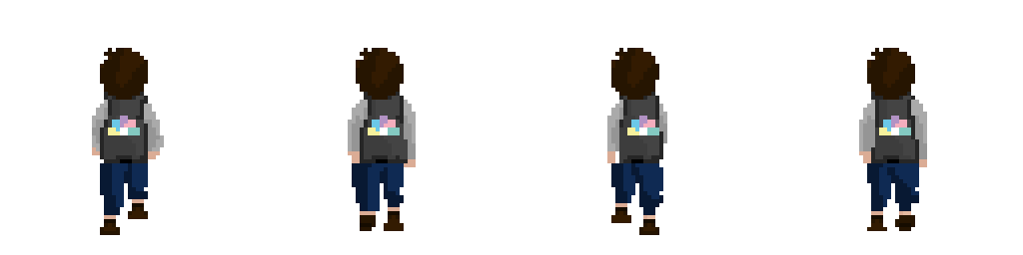
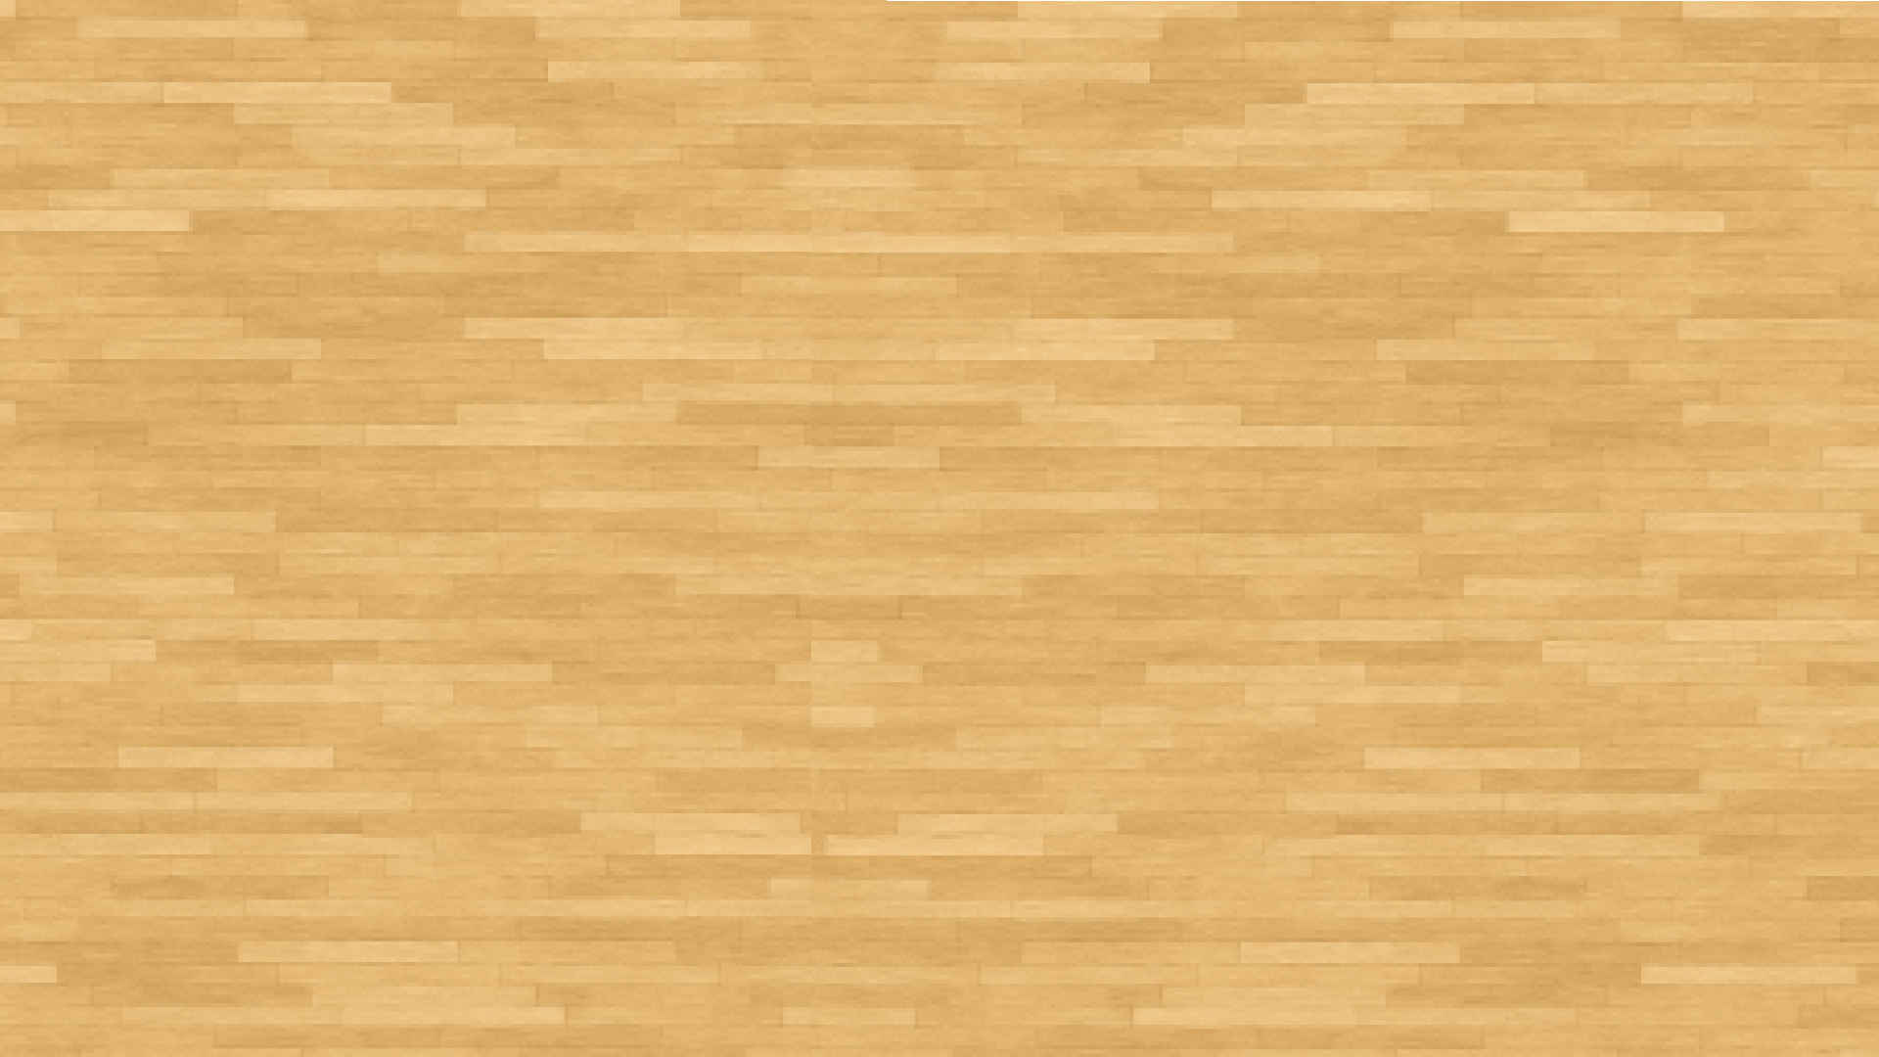


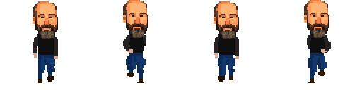
Project Steps – Theme & Design
Created ISC student
HES menu
Corridor floor
Created ISC teachers
Pixelating everything

Slide 7
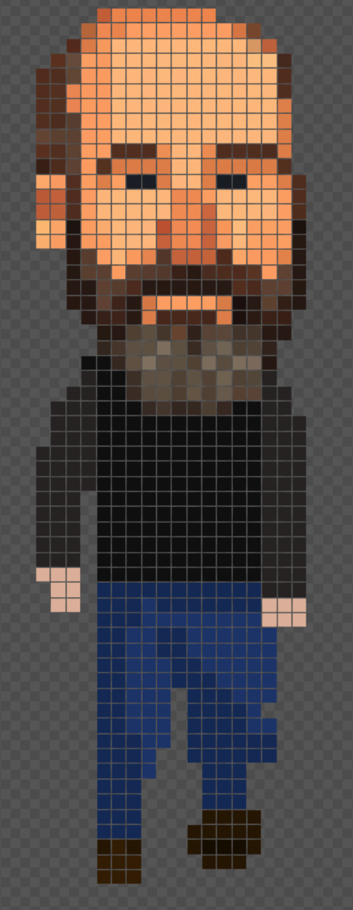

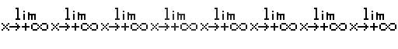



Project Steps – sprites
Entity sprites
Bullets sprites

Slide 8
Project Steps – Hitbox and Bullets

Slide 9
Project Steps – Life points and damages

Slide 10
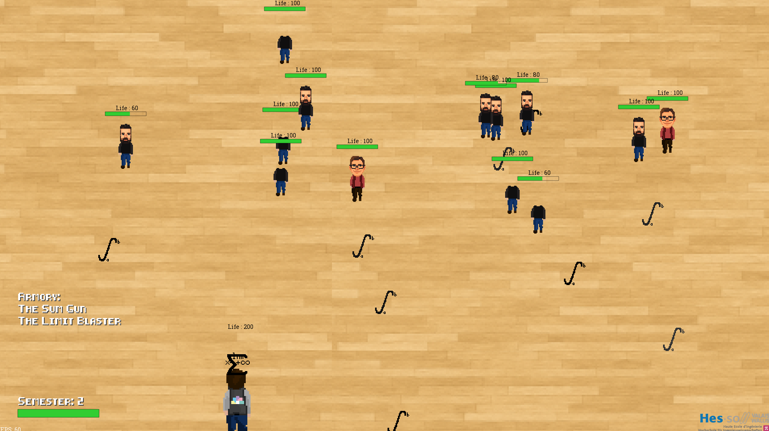
Project Steps – Spawn / die + movement

Slide 11
Project Steps – Scaling and difficulty
 | Easy | Medium | Hard
Semestre 1 | 3 | 5 | 7
Semestre 2 | 6 | 10 | 14
Semestre 3 | 9 | 15 | 21
Semestre 4 | 12 | 20 | 28
Semestre 5 | 15 | 25 | 35
Semestre 6 (boss) | BOSS | BOSS | BOSS
Healing after each Semester (holidays)

Slide 12


Challenges & Bugs
Discovering a library that we never used before
Working as a team and according to all point of the project
Deal with the limited time allowed to finish the whole project
Many specific and different ways to do the same thing using gdx2d
Translating a Java library to a Scala project
Not enough time to add music and sound design
A lot of content and ideas unfortunately not used

Slide 13

Demo

Slide 14

Questions ?

Slide 15
Sources
Course: https://isc.hevs.ch
Gdx2d: https://isc-hei.github.io/gdx2d/doc/install/
Sprite creation Tool : https://www.piskelapp.com/p/create/sprite/

